Slide 1

Synchronization Method for Tram Boarding
For the semifinal match of FIFA WORLD CUP 2006

Slide 2
Presentation by GROUP – 7
Group members:
Mir Azmain Wasif
2021-2-60-108
Section-2
Roll-17
Course Title: Operating Systems
Course Code: CSE325
Semester: Fall 2023
MD. Sajjad Hossain
2021-2-60-136
Section-1
Roll-21
Presented to:
Md. Nawab Yousuf Ali
Professor
Department of Computer Science And Engineering
East West University
Kazi Minhajul Goni Sami
2021-2-60-020
Section-1
Roll-10

Slide 3
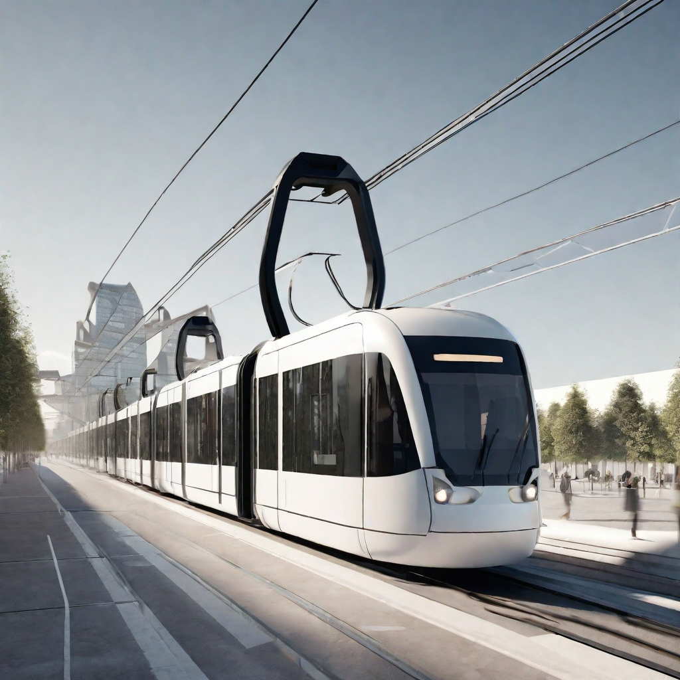
Used Concept
Thread Creation and Joining
Thread Synchronization
Mutex (Mutual Exclusion)
Concurrency
Sleeping/Waiting

Slide 4
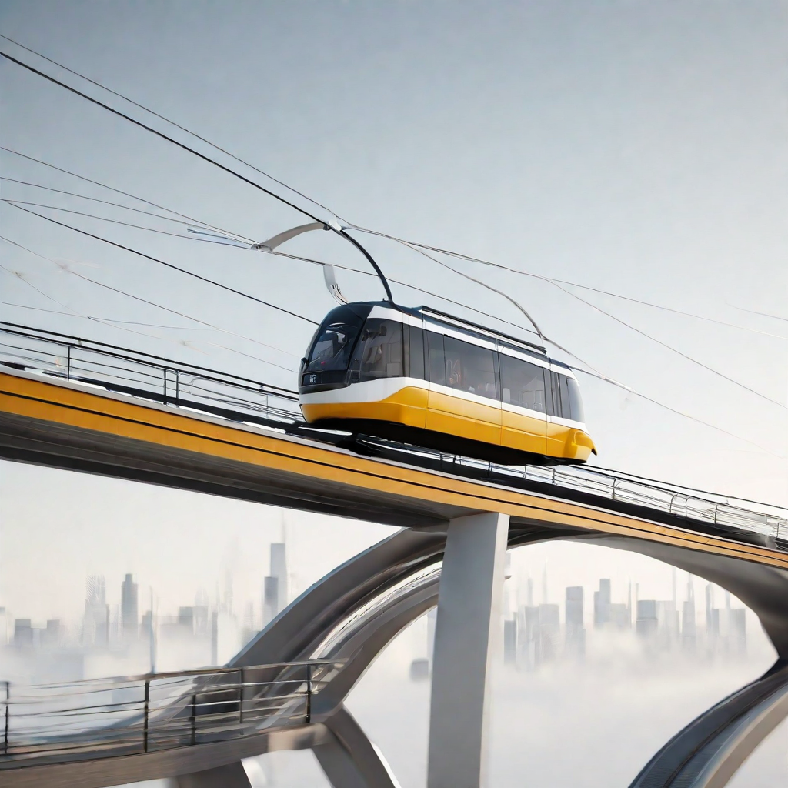

Problem Overview
Problem Description
The problem involves the synchronization of tram boarding between the hotel where the teams are staying and the stadium during the FIFA World Cup 2006.
A fly-over has been constructed between the hotel and the stadium, and a tram car is used to transport the teams.
The tram car can only seat four people and must always carry a full load.
To ensure safety and avoid intimidation, the tram car cannot have three Italians and one German or vice versa.
All other combinations of team members are considered safe.

Slide 5
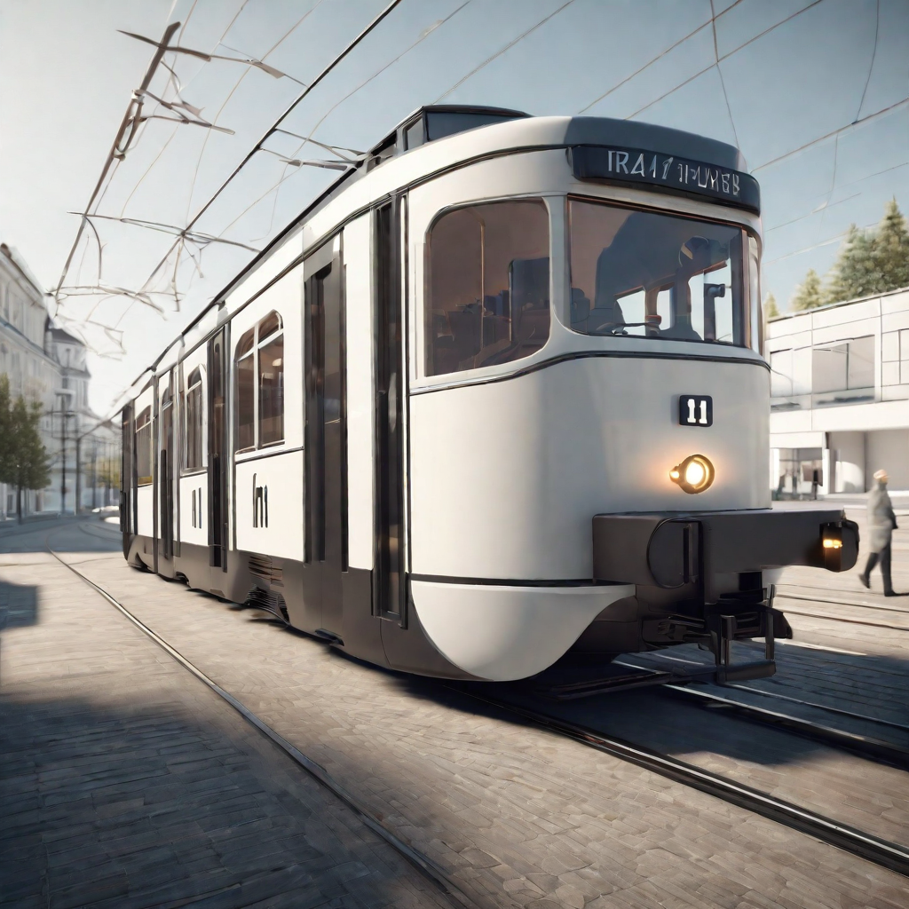
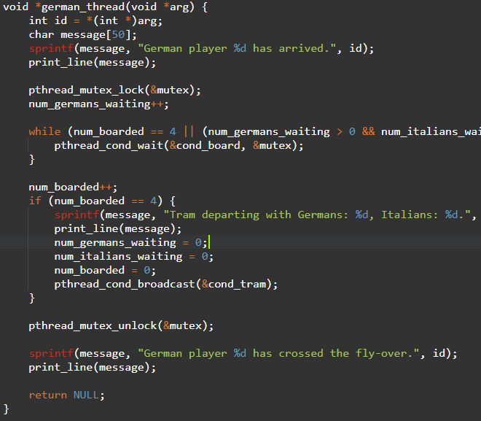

German Thread
The German thread is a synchronization method used during tram boarding in the context of the FIFA World Cup 2006. It ensures a smooth and efficient boarding process for German players.

Slide 6
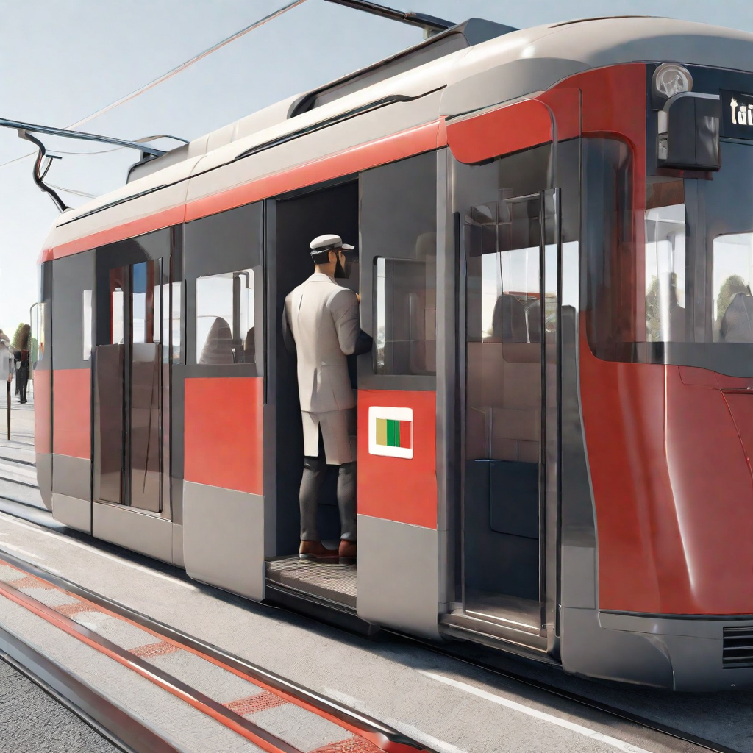
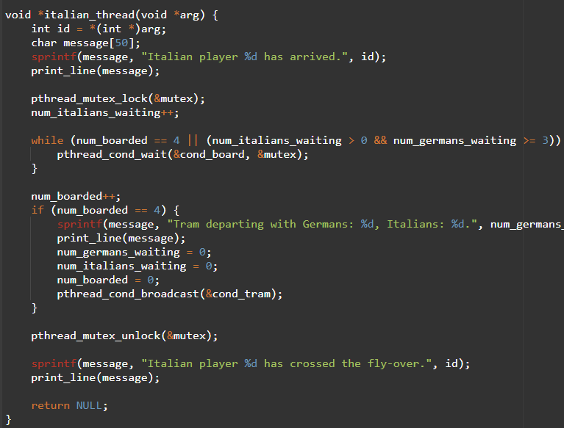
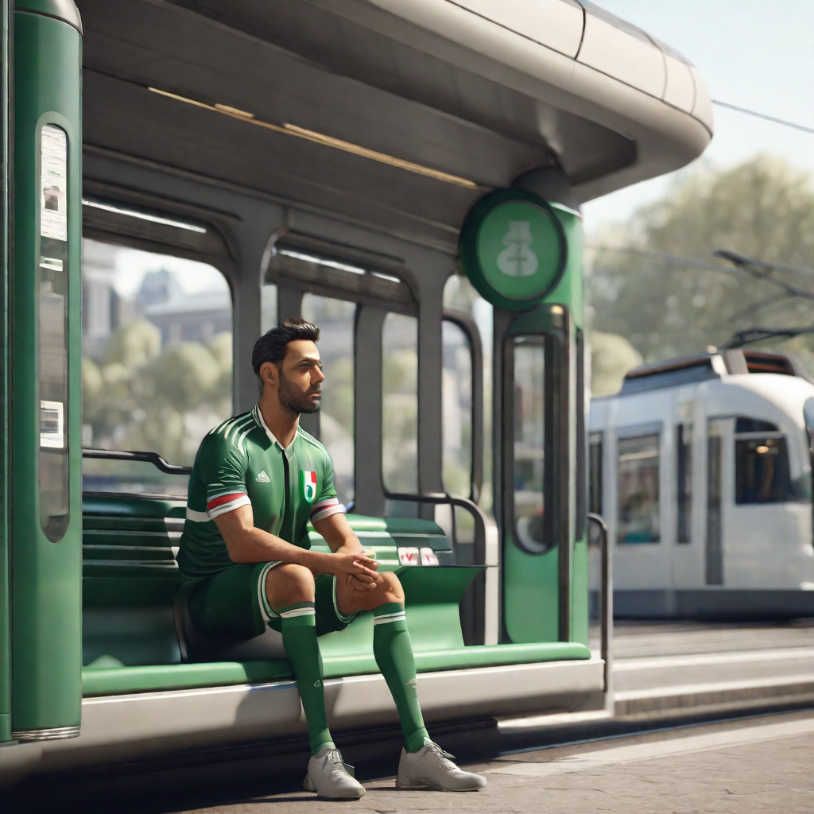
Italian Thread
When an Italian player arrives, they wait and increment the number of waiting Italians. They then check if the tram is already full or if there are more Germans waiting than Italians. If either condition is true, the Italian thread waits. If the tram is full, the Italians board and signal the tram departure when the tram is full. Finally, the Italian player crosses the fly-over.

Slide 7
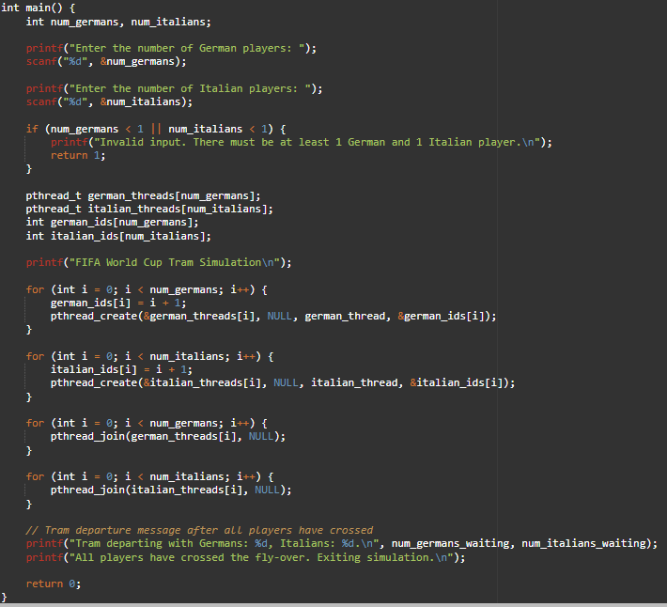
Main Function
The main function in the synchronization method for tram boarding is responsible for coordinating the boarding process and ensuring that all players successfully cross the tram.

Slide 8
CONCLUS!ON
In summary, our synchronization method ensures the secure and fair transport of the German and Italian teams to the stadium for the FIFA World Cup 2006 semifinal. By carefully managing tram occupancy, we prioritize a balanced mix of nationalities, promoting harmony and equality in the transportation process. This solution aims to contribute to a positive and inclusive experience for all involved in this prestigious sporting event.

Slide 9
THANK YOU

